Slide 1
Computational Physics (Lecture 9)
PHY4061

Slide 2
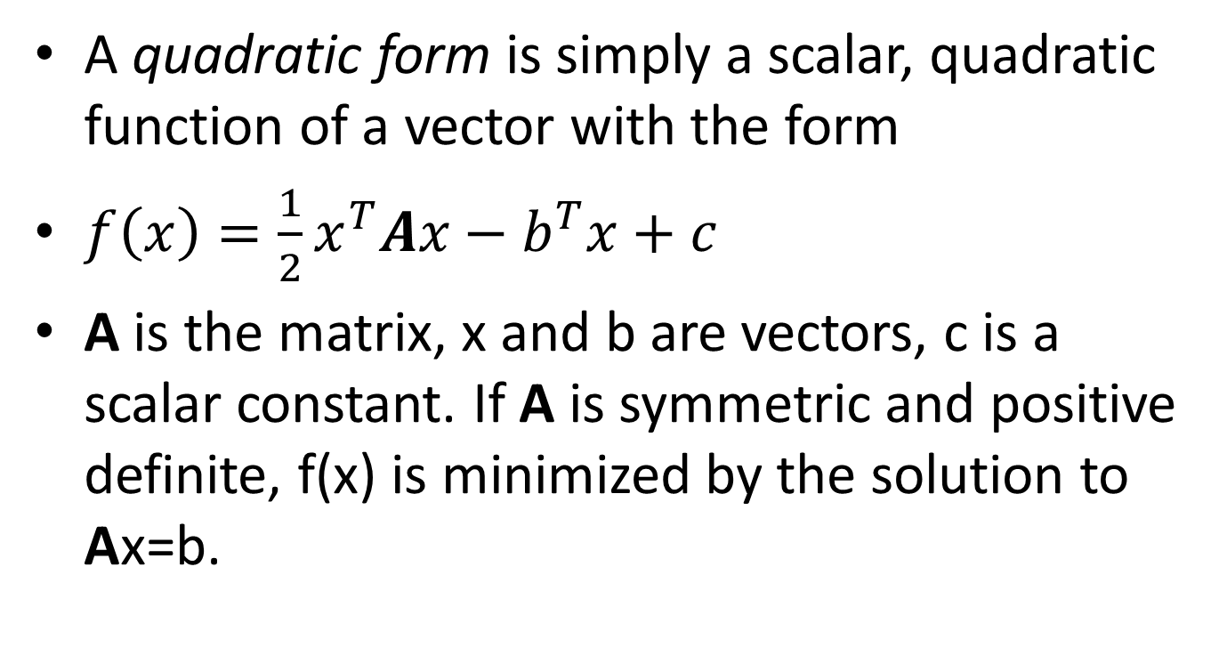
Quadratic form
A quadratic form is simply a scalar, quadratic function of a vector with the form
$f\left(x\right)=\frac{1}{2}x^{T}Ax−b^{T}x+c$
A is the matrix, x and b are vectors, c is a scalar constant. If A is symmetric and positive definite, f(x) is minimized by the solution to Ax=b.

Slide 3
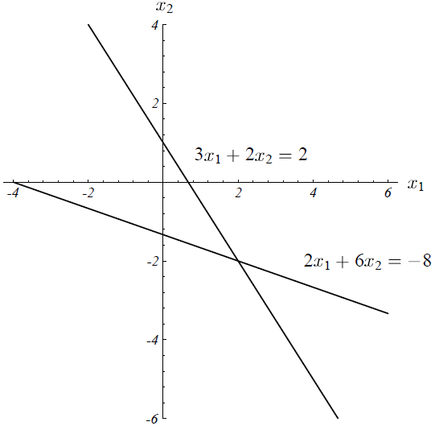

Sample Problem:
$A=\left[\begin{matrix}3 & 2 \\ 2 & 6\end{matrix}\right], b=\left[\begin{matrix}2 \\ −8\end{matrix}\right],$ c= 0

Slide 4
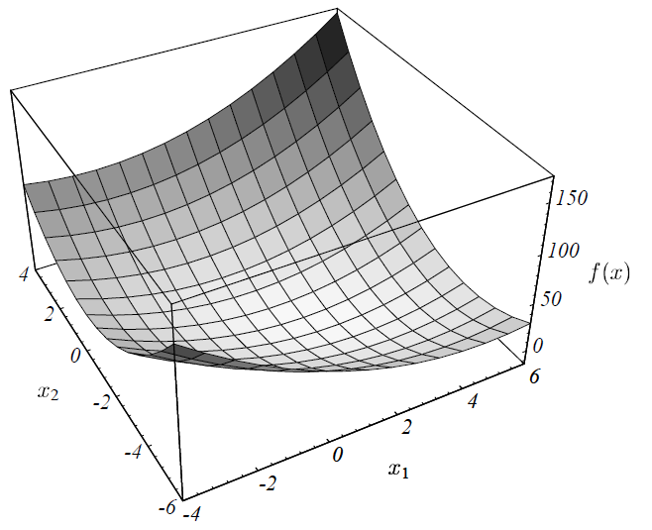

Slide 5
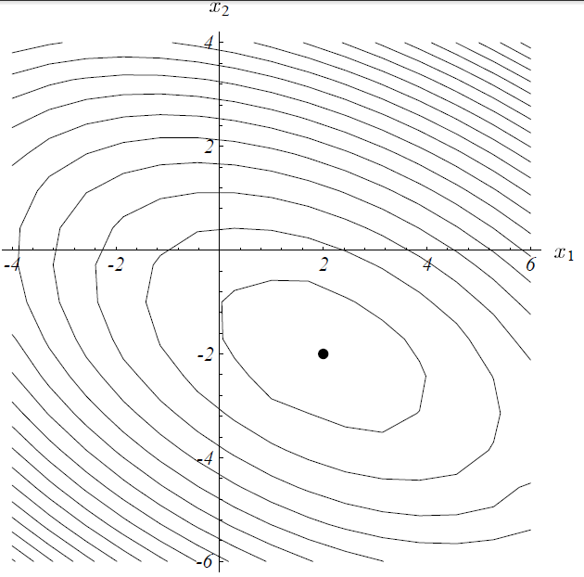
Contour map

Slide 6
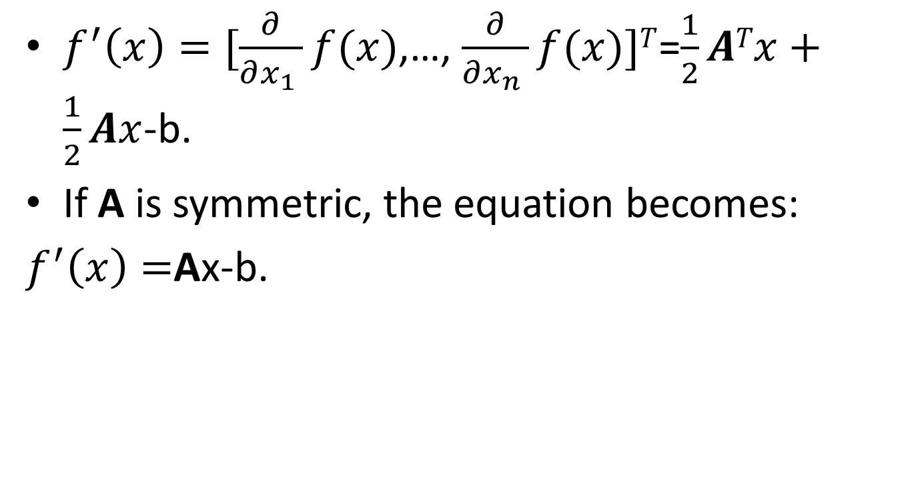
The gradient
$f^{′}\left(x\right)=[\frac{∂}{∂x_{1} }f(x)$,…, $\frac{∂}{∂x_{n} }f(x)]T$=$\frac{1}{2}ATx+\frac{1}{2}Ax$-b.
If A is symmetric, the equation becomes:
$f^{′}\left(x\right)=$Ax-b.

Slide 7
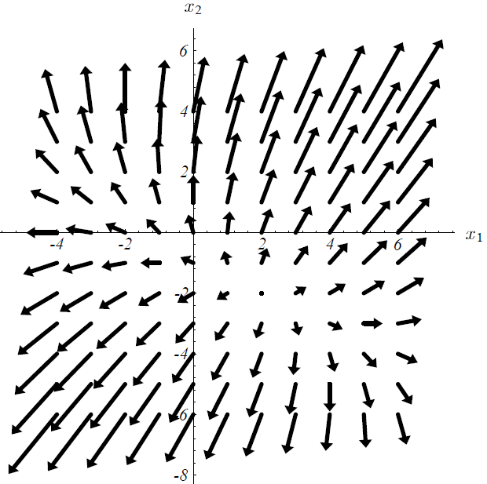

Slide 8
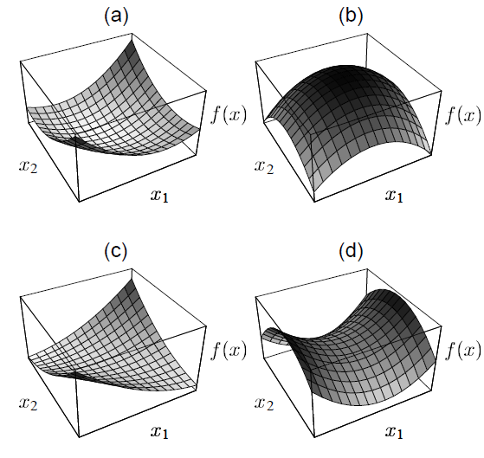

Slide 9
Revisit of Steepest descent
We start from an arbitrary starting point: x₀,
Slide down to the bottom of the paraboloid.
When we take the step, we choose the direction in which f decreases most quickly.
-f’(x_{i})=b-Ax_{i}.
Error : e_{i} = x_{i}-x => how far from the solution.
Residual: r_{i} = b-Ax_{i} => how far from the correct value of b.

Slide 10
Suppose we start from (-2, -2). Along the steepest descent, will fall somewhere on the solid line.
X₁ = x₀+αr₀
How big the step we should take?
Line search
Choose α to minimize f. df(x₁)/dα=0,
So, f’(x₁)^{T}r₀=0
So α is chosen to make r₀ and f’(x₁) orthogonal!

Slide 11
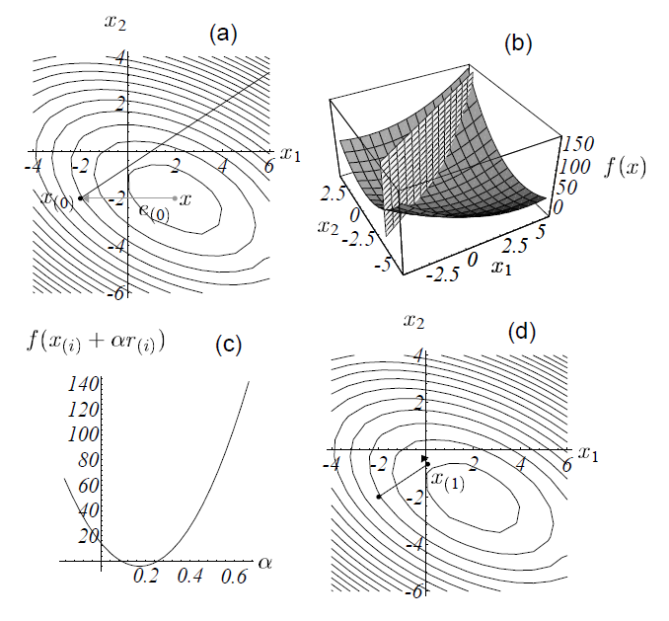

Slide 12
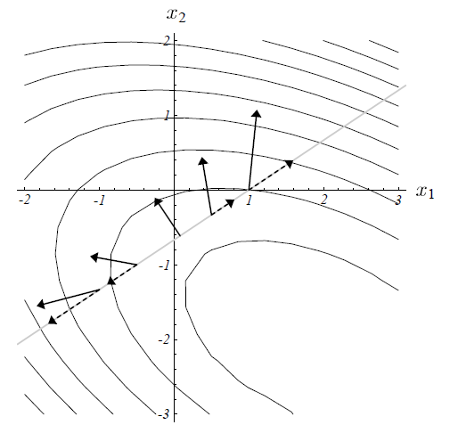

Slide 13
Determine α
F’(x₁)= -r₁
r₁^{T}r₀ = 0
(b-Ax₁)^{T}r₀ = 0
(b-A(x₀+ αr₀))^{T}r₀ = 0
(b-Ax₀)^{T}r₀ = α(Ar₀)^{T}r₀
r₀ ^{T}r₀= αr₀^{T}(Ar₀)
α =(r₀ ^{T}r₀)/ (r₀^{T}Ar₀)

Slide 14
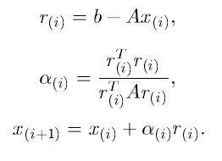
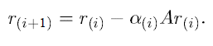
General method of Steepest Descent

Slide 15
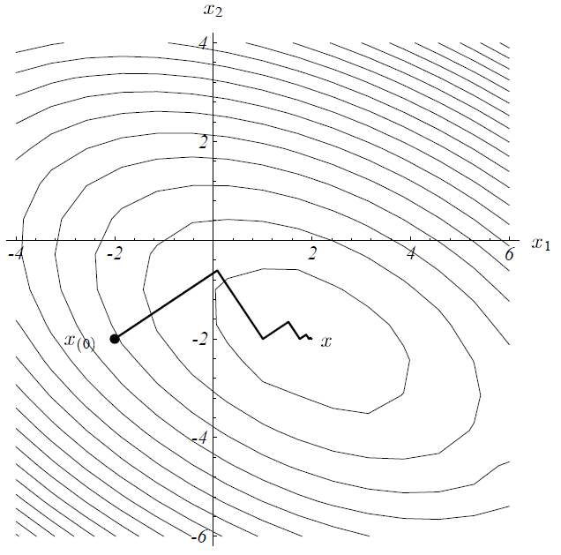
Any problems can you perceive?

Slide 16
Conjugate directions
SD often takes steps in the same direction!
If we take n orthogonal steps, d₀, d₁ … d_{n-1}, each step has the correct length, after n steps, we are done！
In general, for each step, we have
x_{i+1}=x_{i}+α_{i}d_{i}
e_{i+1} should be orthogonal to d_{i}
d_{i}^{T}e_{i+1} = 0 (e_{i+1} = x_{i+1}-x= e_{i}+ α_{i}d_{i})
d_{i}^{T} (e_{i}+ α_{i}d_{i})=0
α_{i}=-d_{i} ^{T}e_{i}/(d _{i} ^{T}d _{i})

Slide 17
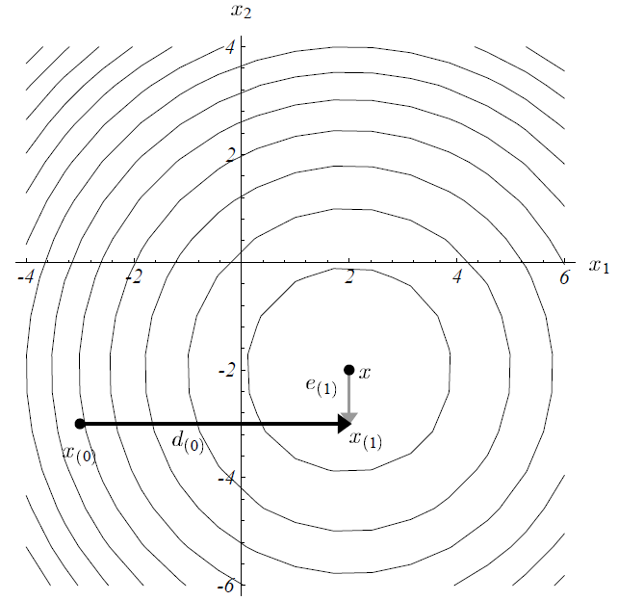

Slide 18
Useless! We don’t know e_{i}.
Instead, we make d_{i} and d_{j} A-orthogonal, or conjugate.
d_{i} ^{T}Ad_{j} = 0

Slide 19
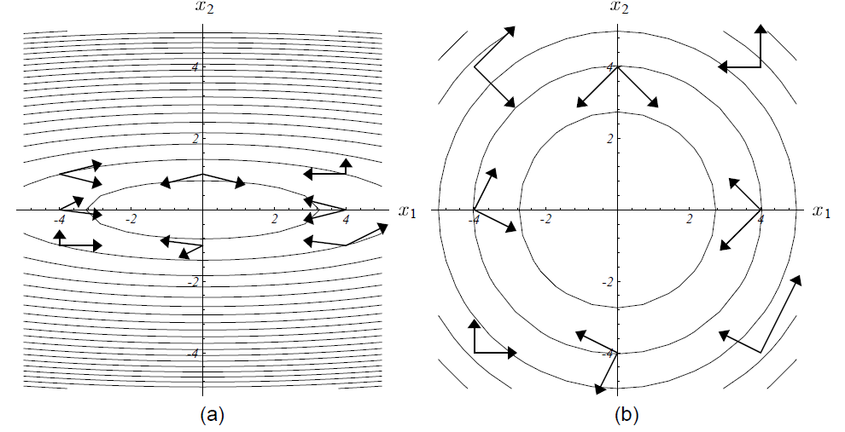

Slide 20
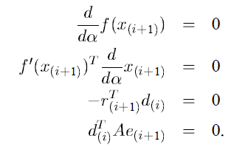
New requirement:
e(i+1) is A-orthogonal to d(i)
Like SD, we need to find the minimum along d(i)
Here, x_{i+1}=x_{i}+α_{i}d_{i}
A e _{i+1} = A (x_{i+1} –x) = Ax_{i+1}-Ax=Ax_{i+1}-b = -r_{i+1}

Slide 21
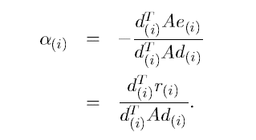
This time, evaluate the α(i) again,
A e _{i} = A (x_{i} –x) = Ax_{i}-Ax=Ax_{i}-b = -r_{i}

Slide 22
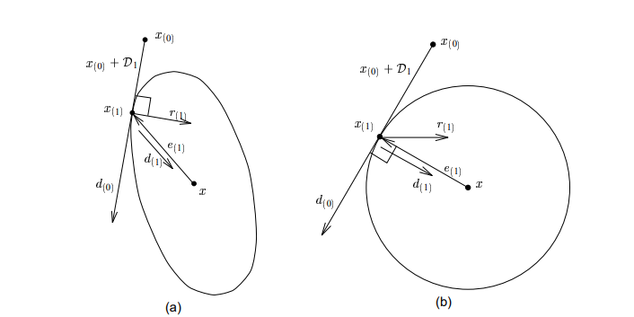

Slide 23
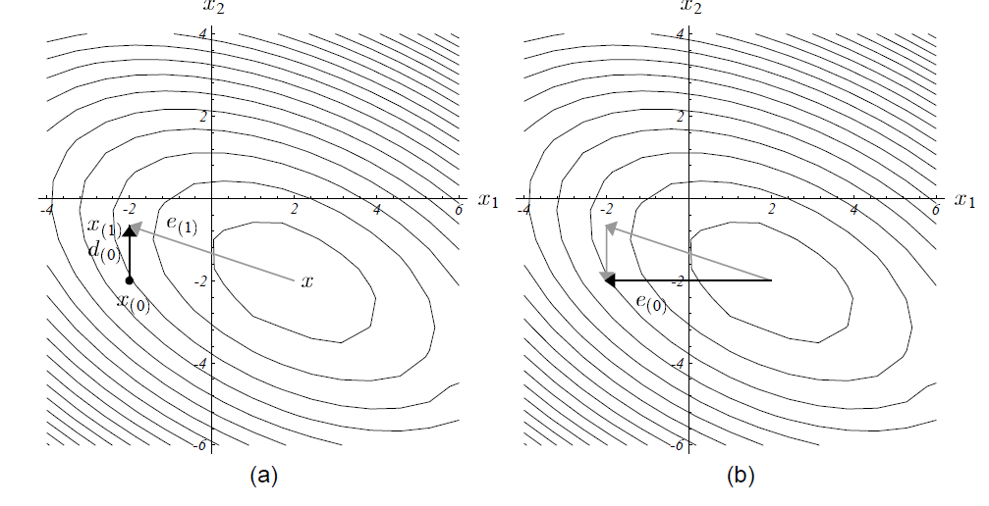

Slide 24
Conjugate Gradients
Reading material:
https://www.cs.cmu.edu/~quake-papers/painless-conjugate-gradient.pdf
Just the Conjugate directions method where the search directions are constructed by conjugation of the residuals.
u_{i}=r(_{i})

Slide 25
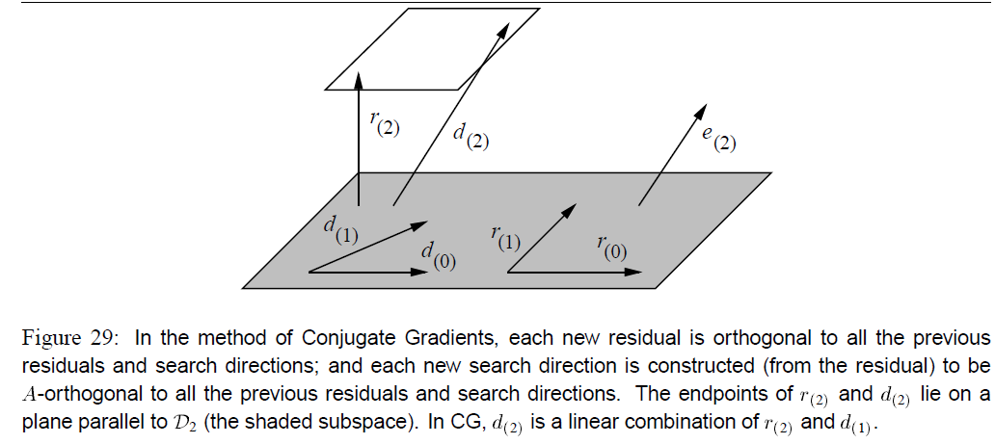

Slide 26
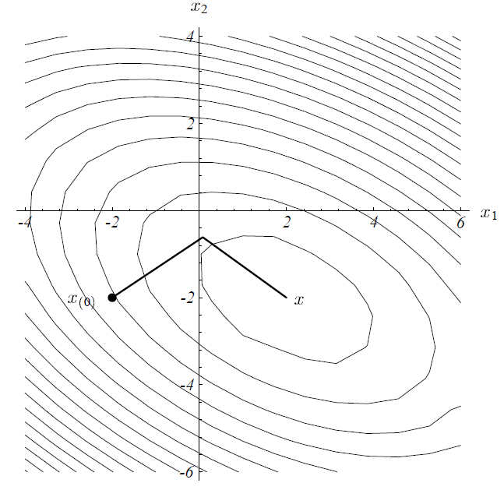

Slide 27
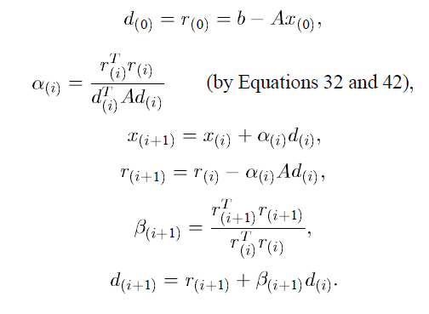
General Method

Slide 28
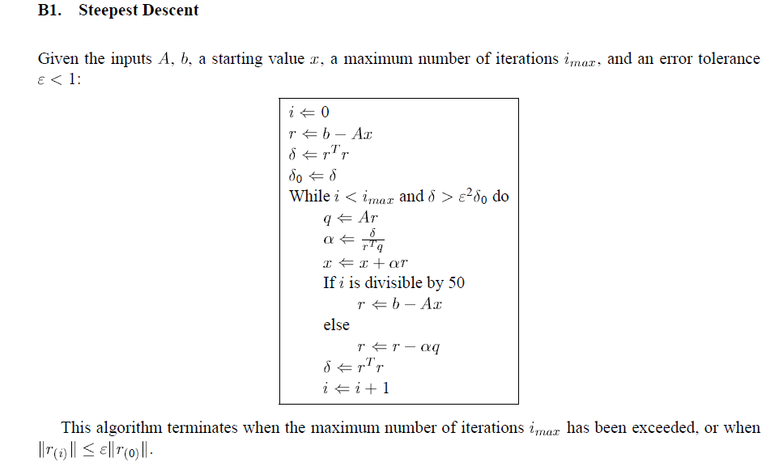
Sample code for SD

Slide 29
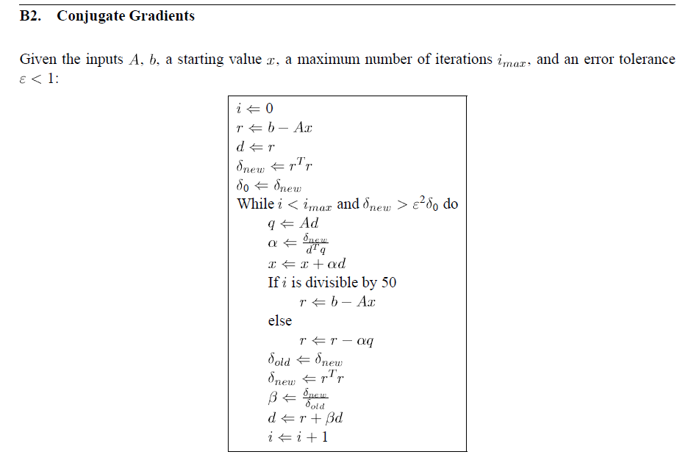

Slide 30
[

Slide 31
Revised Algorithm using line minimization for nonlinear functions

